Slide 1


UrbanWater
darren.op@redskies.io
August 2016
This project has received funding from the European Union’s Seventh Framework Programme for research, technological development and demonstration under grant agreement no. 318602. This publication reflects only the authors’ views and the European Union is not liable for any use that may be made of the information contained therein.

Slide 2

Final Review Meeting
Contents
Overview of UrbanWater
Some results from pilots
Thoughts for the future of Smart Utilities and Smart Citites
http://www.urbanwater-ict.com

Slide 3
1. Project Summary
http://www.urbanwater-ict.com

Slide 4

Project Summary
http://www.urbanwater-ict.com

Slide 5
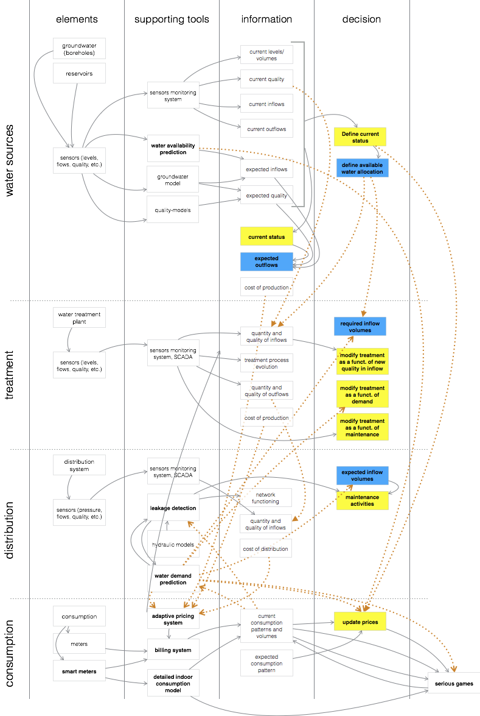
Project Summary
What does Smart Water cover?
Water Sources
Water supplies across rivers, reservoirs and wetlands.
Water Treatment
Effective treatment of water to provide clear safe water
Water Distribution
Reducing water loss and maintaining water quality
Water Consumption
Managing demand, modifying consumer behaviour, meeting demand
http://www.urbanwater-ict.com

Slide 6
Project Summary
Project Aims
EC project to bring smarter water management to Europe
Collaboration of water utilities, EC, universities and smart solution companies
Improve & encourage efficient end to end water management
Benefit End Users, Utilities, Public Authorities & General Public
Provide customers with tools to reduce water consumption
Help Water Utilities meet demand & reduce cost
Create partnerships across the water chain
Encourage innovation while solving reach challenges of scale and security
http://www.urbanwater-ict.com

Slide 7
Project Summary
Example installation
Year | 1 | 2 | 3 | 4 | 5
Total benefits | €150,598,700 | €170,457,874 | €190,326,231 | €200,503,956 | €210,691,235
Total costs | €30,115,000 | €27,685,900 | €28,172,618 | €28,736,070 | €29,310,792
ROI | 400% | 516% | 576% | 598% | 619%
http://www.urbanwater-ict.com

Slide 8
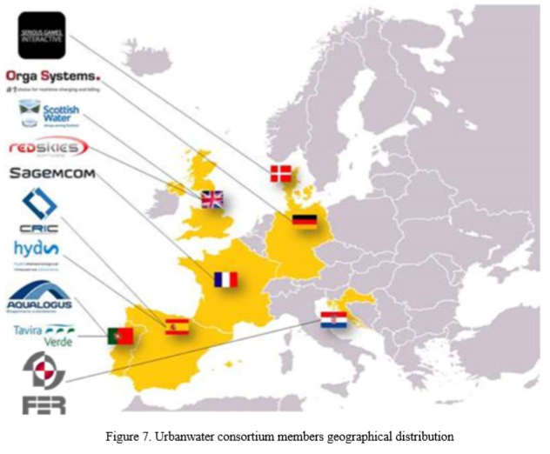
Project Summary
The Consortium
Red Skies (UK)
Aqualia (Spain)
Scottish Water (UK)
Tavira Verde (Portugal)
Ovod (Czech Republic)
Ateknea (Spain)
Aqualogus (Portugal)
Hyds (Spain)
Sagemcom (France)
Orga Systems (Germany)
University Zagreb (Croatia)
Serious Games (Denmark)
http://www.urbanwater-ict.com

Slide 9
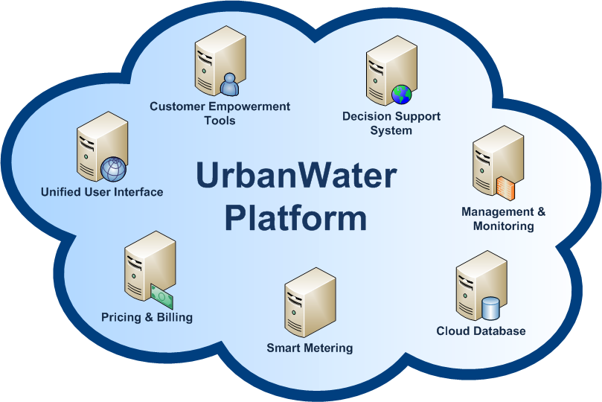
Project Summary
The UrbanWater (UW) Platform provides an innovative modular cloud ICT system and services for efficient and integrated management of urban water resources. This Platform offers many services developed by different companies and is open to 3rd parties
The European Union under the call FP7-ICT-2013.6.3 co-funded the Project UrbanWater to boost the implementation of Information and Communication Technology (ICT) tools on the Water Community
http://www.urbanwater-ict.eu

Slide 10
Project Summary
Merging different data sources to ease urban water management
http://www.urbanwater-ict.eu

Slide 11
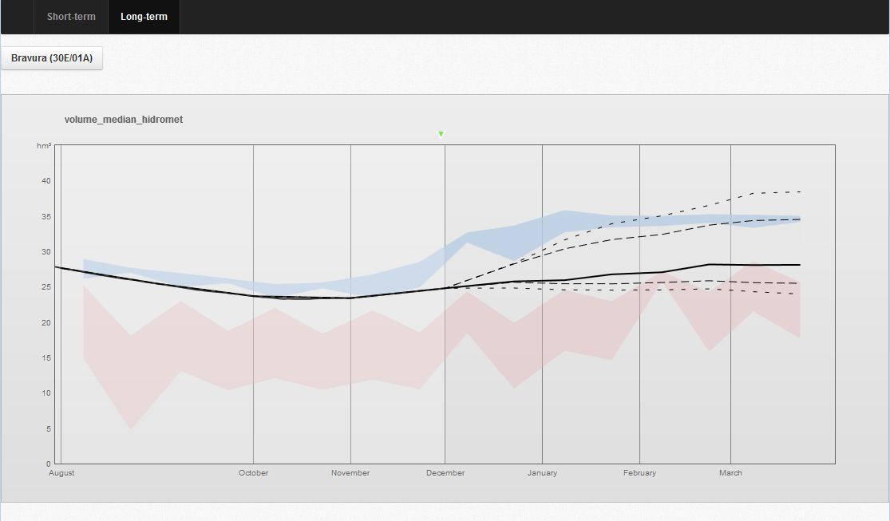
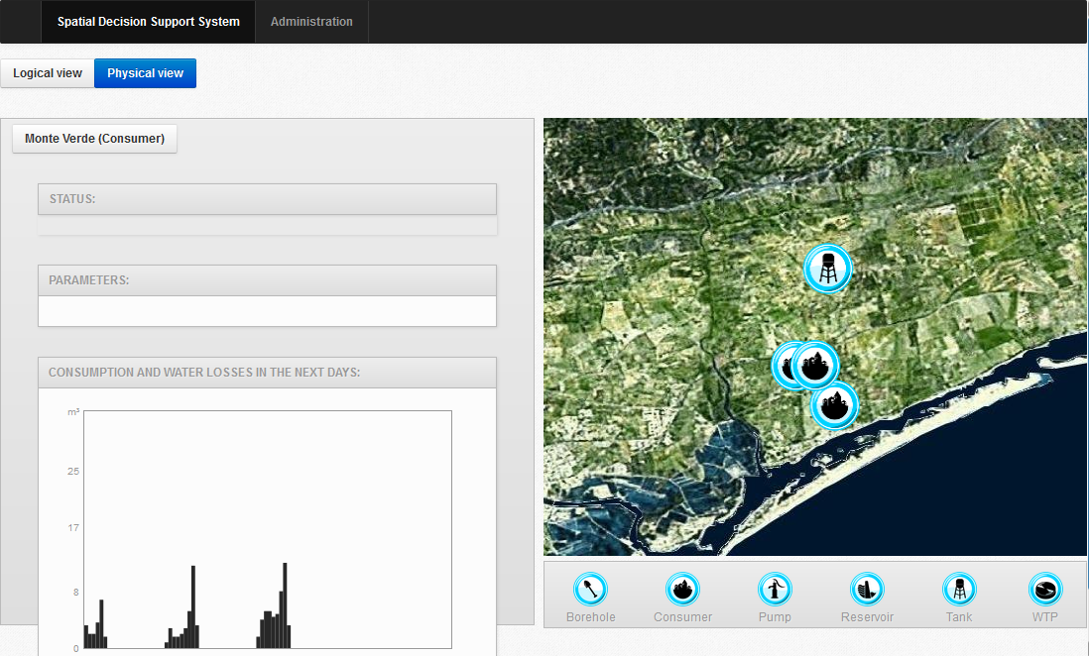
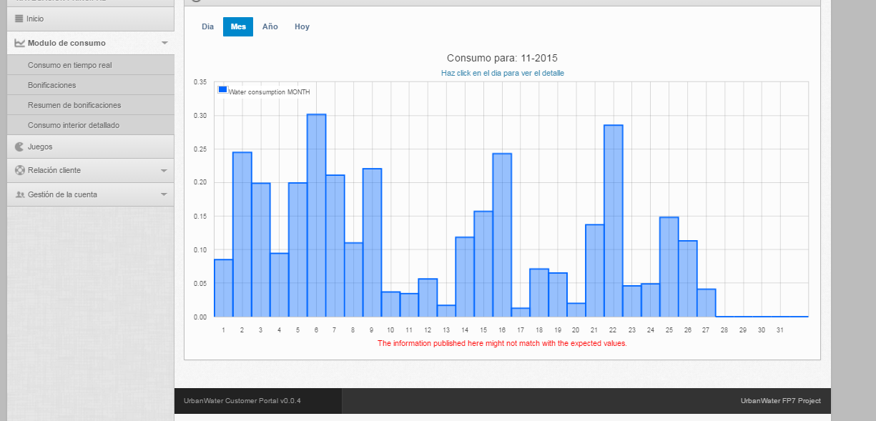
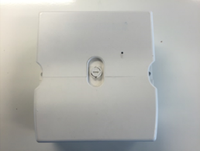
Project Summary
We have developed:
Offline predictors, classifiers, …
WAPS, WDPS, DICM, APS
Online service implementation
All modules
Web portals
COP, UCP
Hardware and firmware
MPG
http://www.urbanwater-ict.eu

Slide 12
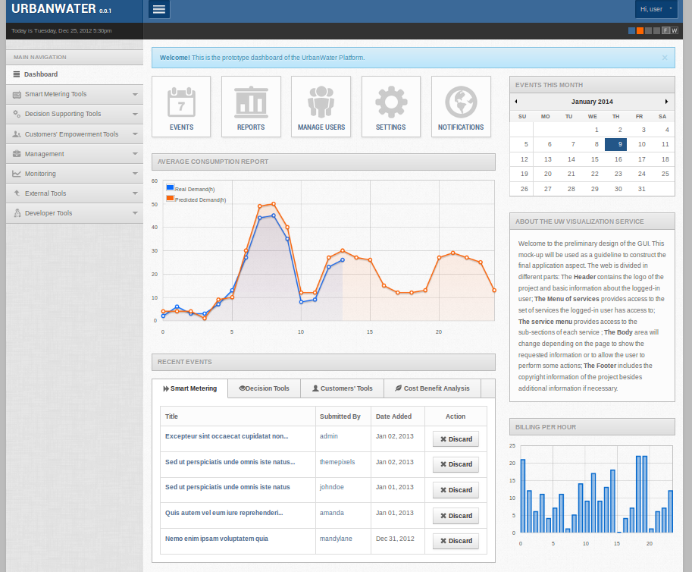
Project Summary
Modules developed
Water demand prediction system
Water availability prediction system
Leakages detection system
Decision support system
Customers’ on-line platform
Serious games development
Adaptive pricing system
Automatic billing system
Multi-meter gateway
http://www.urbanwater-ict.com

Slide 13
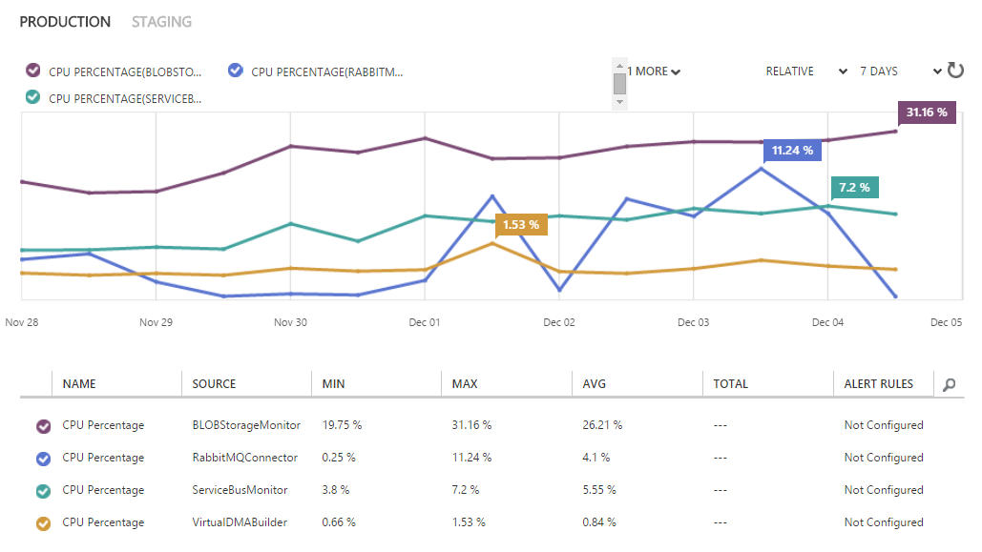
UrbanWater Main results
Data Management Cloud Platform (DMCP)
The DMCP manages data for all modules including meteorological, network, water source and meter data.
Data ranges from high frequency datasets delivered every several seconds to batches arriving hourly.
KPIs | Expected | Preliminary
UW connector instances | 2 to 5 | 4
Blob instances | 1 to 2 | 2 (dir size)
Meter upload processors | 1 to 4 | 2
Meter files per day | 72 | 845
Meter readings per day | >10,000 | > 186,000
Weather data records per day | 200 to 500 | ~350
Positives
Has scaled dynamically as required
Platform has generally performed reliably with only one outage
Have been able to quickly add new modules
Have found strong commercial interest
Negatives
One major Europe wide outage to AzureAD
Homomorphic performance impractical for commercial use. Forced positive research into blockchain and Ethereum
Coordination & technology challenges for partners
Meter readings are locked for audits but need to be post-worked
Complex processing of data stored in the cloud.
http://www.urbanwater-ict.com

Slide 14
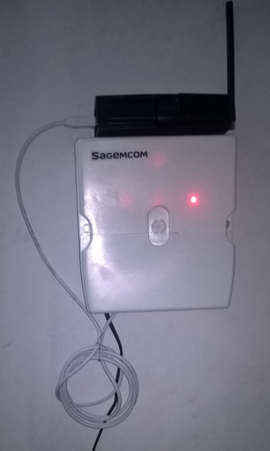
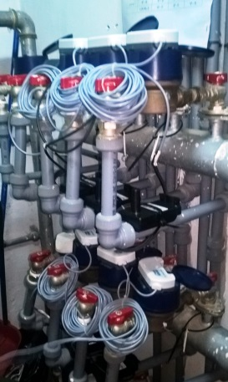
UrbanWater Main results
Multi Protocol gateway (MPG)
A new gateway able to support different types of data protocols.
The gateway is in charge of connecting the gathering devices with the core server through a single point.
The purpose is to accept multiple wireless technologies simultaneously in order to aggregate many gateways in one single device.
To reduce the number of repeaters and decrease maintenance cost, the Multi-protocol gateway uses new RF (Radio-Frequency) raising technologies at 169MHz or 868MHz frequencies. These gateways associated with Direct-Sequence Spread Spectrum (DSSS) modulations helps to avoid most of the repeaters and deal with water meter data collection.
Good behaving of the MPG, giving requested filed flexibly and cost effectiveness. Multi protocols validated in labs
Transmission of meter data every 2 second created as foreseen,
- High frequency transmission validated (up to 43 200 indexes values to be sent per day and per meters)
- RF collision that are not solved by data retransmission
- other transmission issues under analysis (Lora Module issue or software issues in the data transmission chain)
- Battery life issues (2 meter out of 7)
http://www.urbanwater-ict.com

Slide 15
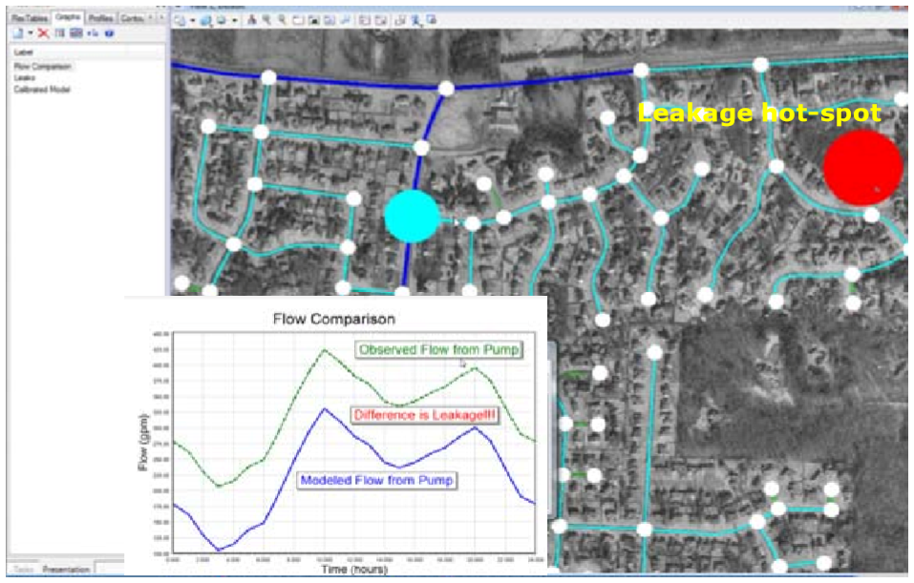
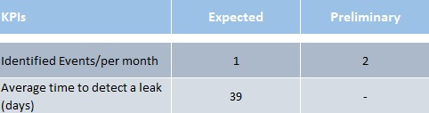
UrbanWater Main results
Leakage Detection System
Integrates data coming from two sources:
i) Historical and real-time measurements such as pressures, flows, heads, relative pumping speeds, demands at key locations, tank and reservoir levels and other relevant network operation data (weather conditions, seasonality effects etc)
ii) Data generated by hydraulic simulation modelling package (e.g. EpaNET / WaterCAD and others) as “virtual sensors data” for different realistic scenarios and alternatives of the network operations.
Generate leakage or pipe bursts events based on statistical analysis of the measured data streams based on historical data, such as trends in the minimum night flows, differences between Measured and Forecasted demands, differences between the measured total demands and the throughput of the system and other indicators.
Hydraulic model for the pressure of the district zone where the leakage event was raised, and global optimization techniques in order to point the most-likely location of the leakage.
http://www.urbanwater-ict.eu

Slide 16
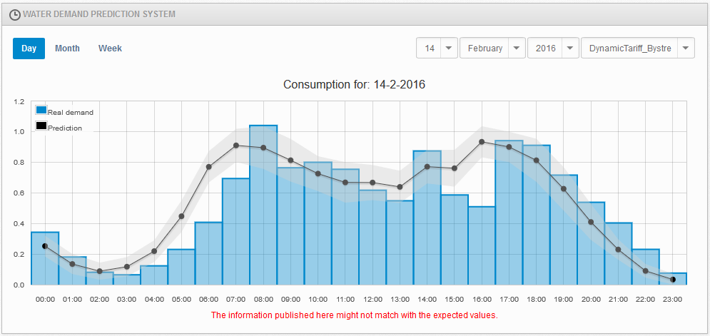
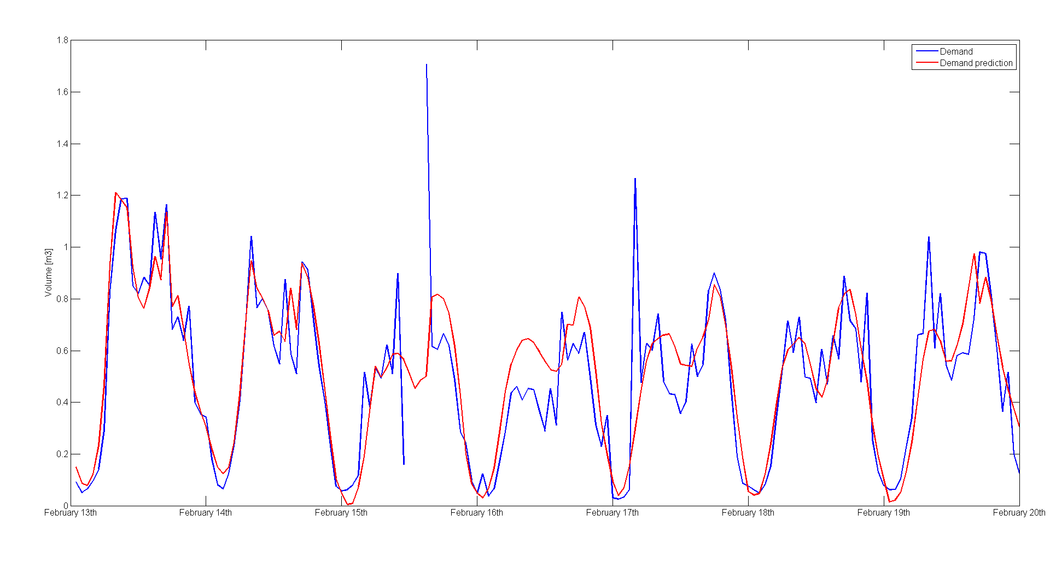
UrbanWater Main results
Water Demand Prediction System
Detailed indoor consumption models that are programmed online through the UrbanWater dashboard.
Computation of prediction uncertainty based upon input data uncertainty.
Algorithms are developed for the tuning of water demand models in selected model forms, based on new water consumption and other input data.
KPIs | Expected | Preliminary
Mean Average Percentage Error | <10% | 5-12% for AdA, lead-time dependant
Mean Average Error | <10% of mean demand | Corresponds to expected
Pecentage of actual demand leaving 1σ uncertainty bound | 68% | Corresponds to expected for validation in AdA
http://www.urbanwater-ict.eu

Slide 17
UrbanWater Main results
Water Availability Prediction System (WAPS)
Short term 14 day prediction using a network of Rain Gauges, River Level Sensors, Weather Radar Data and Numerical Prediction Models (NPM).
Integrate this into hydrological models to provide forecasts on upper part of the water distribution chain.
Analyse seasonal forecasting based on the statistical analysis of historical information.
KPIs | Expected | Preliminary
Precipitation forecasts error | < 10% | 8%
Catchment discharges error | - | -
Long-term reservoir volume error | < 10% | < 20% (2 months ahead)
Producing a description of hourly rainfall fields (1 km2 resolution), as a combination of weather radar data and rain gauges using geostatistical approach.
Producing a description of hourly forecasted rainfall fields (1 km2 resolution), up to 6 hours as a combination of Nowcast Weather Radar Data and NWP (Numerical Weather Prediction) Data.
High-resolution description of hourly forecasted rainfall fields (4x4 km2) up to 3 days using NWP information.
Hourly forecasted rainfall fields (12x12 km2) up to 14 days using NWP information.
http://www.urbanwater-ict.eu

Slide 18
UrbanWater Main results
Spatial Decision Support System (SDSS)
The SDSS combines output from all the platforms tools to provide an integrated vision of the network.
The SDSS has the following elements:
A deductive element that collects information from all the tools in order to define scenarios of availability and demand. Users interact with these
to apply standards and operational strategies to the system. The deductive element acts as an expert system that combines the operation rules or polices of the users with its inference capabilities to provide decision making abilities.
A domain expert element that supports the learning process and that can be trained using test scenarios over the deductive element.
A GIS (Geographic Information System) that integrates the spatial information with a library of web services - WMS (Web Map Service), WFS (Web Feature Service). The SDSS make’s extensive use of open standards and platforms for input and output data (input data interfaces provided by the Open Geospatial Consortium (OGC)), web services ((WFS), (WMS) and Catalogue Service for Web (CSW)), and the ability to incorporate new functions by customers (via Web Feature Services).
KPIs | Expected | Preliminary
Tank volume prediction error | < 10% | 15%
Tank inflow volume prediction error | < 10% | 20%
Reservoir volumes prediction error | < 5% | 10%
WTP product prediction error | < 5% | -
http://www.urbanwater-ict.eu

Slide 19
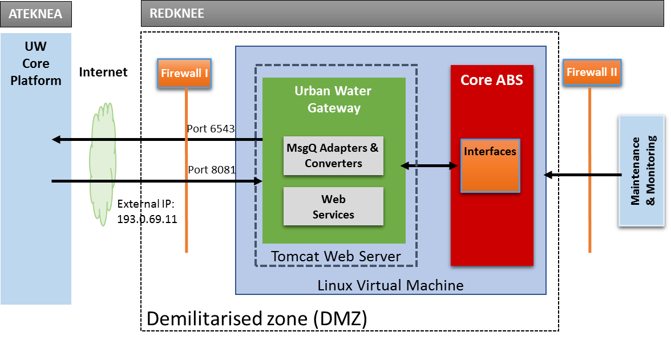
UrbanWater Main results
Automatic Billing System (ABS)
The automatic and dynamic billing system including innovative price plans & tariffs.
Provides real-time notifications for the customers’ water consumption.
Dynamic billing encompasses rating and charging water consumption in regular intervals (e.g. every 15 min).
KPIs | Expected | Preliminary
Installed Tariffs | 4 | 4
Processing Time (Rating and Charging internally inside ABS) | 250/sec (i.e., 4 ms) | 400/sec (i.e., 2.5 ms)
Round Trip Time to get & process meter reads (from ABS via UW CP to DMCP and back) | 5 sec | 15 sec
Overall ABS Processing Time per day with 1.000 meters and hourly meter reads | 10 min | 15 min
http://www.urbanwater-ict.com

Slide 20
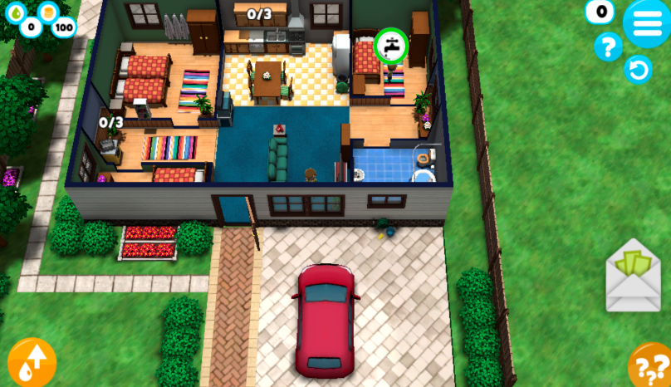
UrbanWater Main results
Two Games: The Water Mansion and The Last Drop
Game 1 (micro level): The Water Mansion – where the player manages a household, trying to fulfill the water consuming activities of its inhabitants while at the same time upgrading various water saving devices (ex. faucets, IQ of inhabitants)
Game 2 (macro level): The Last Drop – where the player controls a water facility. The main task for the player is to meet the water consumption demands of a near-by city, making sure peak levels are reached and preventing polluted water from reaching the city.
KPIs | Expected | Preliminary
Change in consumer knowledge | 20% | N/A
Behavioural change derived from game | 10% | N/A
Conclusions are still pending the field trials with end-users. Here users within and without the system will be compared to identify changes between consumers exposed to the games and consumers not exposed to the game.
http://www.urbanwater-ict.eu

Slide 21
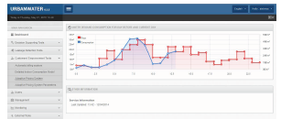
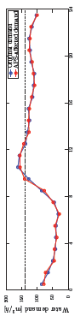
UrbanWater Main results
Adaptive Pricing System
We provide a strategy for adaptive water pricing that uses the water demand forecast and water supply prediction together with the time of use (TOU), critical peak pricing (CPP) and a set of charging mechanisms such as real-time rating and charging, interval billing and revenue.
Optimization methods are then put in place to compute the water price profiles that will ensure correct water supply system functioning and water savings.
Functional interfaces for adaptive pricing, and a rule-based mechanism for notifications enhances the transparency for end-customers.
KPIs | Expected | Preliminary
Price responsiveness matrix | Non-zero | <Compare predicted demand to real demand>
Technical costs for the utility and cummulative costs for customers lowered | 5% | Needs longer period of validation
http://www.urbanwater-ict.eu

Slide 22
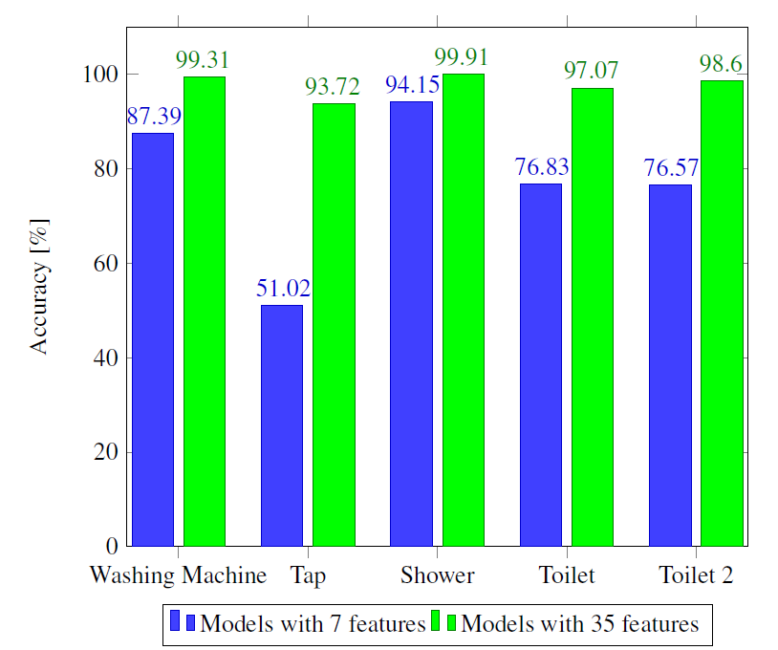
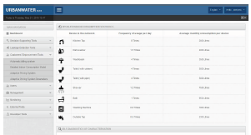
UrbanWater Main results
Detailed Indoor Consumption Model
Features:
derived procedure for accurate delination of consumptions recorded on commercial meters with 1 liter quantization level
data base of pre-tuned models from UK households used to perform DICM commissioning for newly entering end-customer
15 users with high resolution meters in Almeria on-line, with results presented via Customer On-line Portal through which feedback from customers is also sought
15 users with high resolution meters in Janovice
KPIs | Expected | Preliminary
Percentage of the correctly classified water usages | 60-70% | <Interactive work>
Ability to improve the characterization model for a particular household based on the users feedback | Accuracy increased | Needs longer period of validation
http://www.urbanwater-ict.eu

Slide 23
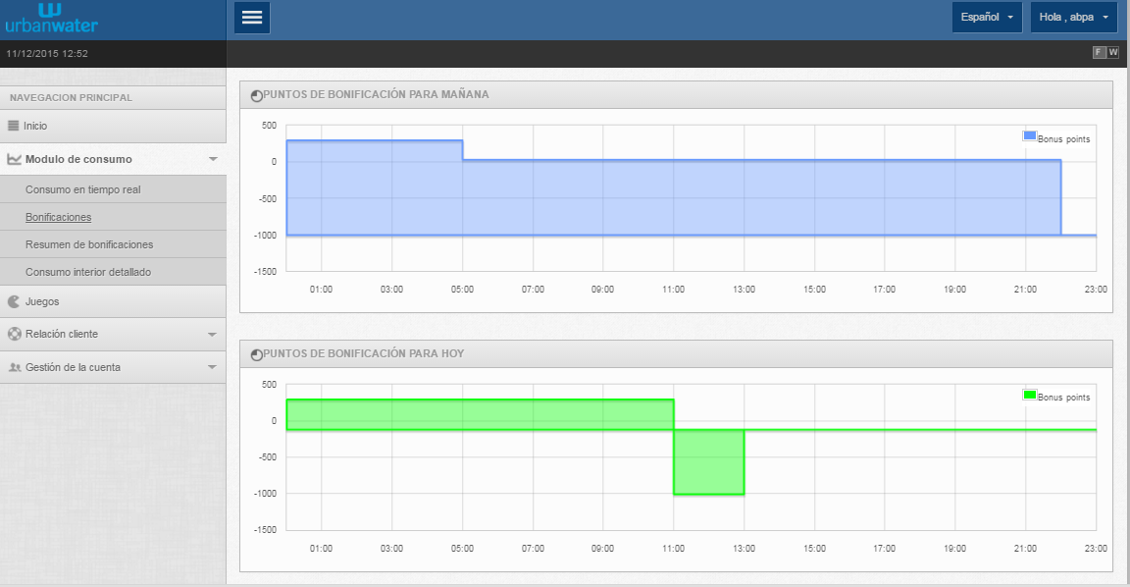
UrbanWater Main results
Customer On-line Portal
Web based on-line platform accessed through any smart device.
Allows customers to monitor their real-time consumption as well as see their water consumption forecasts.
Displays customers statistics and patterns and allows two way communications between utility and customers
KPIs | Expected | Preliminary
# Registered users | 150 | 17
% Active users | 50% | 25%
Session duration
More visited paged
Current conclusions are derived mainly from feedback received from Customer Care departments in the utilities.
In the final version of the validation reports an analysis the changes in customers behaviour and its relation with their activity in the platform will be provided.
http://www.urbanwater-ict.eu

Slide 24
2. Main results
http://www.urbanwater-ict.com

Slide 25
UrbanWater Main results
Customer On-line Portal
The Customer Online Portal is being used by customers of OVOD and AQUALIA in Janovice and Almería.
Customers can check the consumption, consult bonification points and access to the UrbanWater games
Users activity in Almeria has been ….
KPIs | Expected | Preliminary
# Registered users | 150 | 97
% Active users | 50% | 45%
Current conclusions are derived from data gathered regarding users activity in the platform and comments received from users through the platform of by current CRM services of the utilities.
In the final version of the validation reports an analysis the changes in customers behaviour and its relation with their activity in the platform will be provided.
http://www.urbanwater-ict.com

Slide 26
UrbanWater Main results
Data Management Cloud Platform (DMCP)
This module is managing data for all the pilot sites including meteorological, network, water source and meter data.
Readings arrive at various intervals ranging from high frequency meter readings every few seconds to large datasets hourly or daily. Events are raised to inform modules of new data which can then query aggregated results.
KPIs | Expected | Preliminary
UW connector instances | 1 to 10 | 3 required
Blob monitoring | 1 to 2 | 1 required
Meter upload processors | 1 to 10 | 2 required
Meter files per day | 72 | 845
The DMCP has scaled over time as the amount of data being ingested and queried has increased. We have faced one major infrastructure outage from the cloud provider and have continued to develop the DMCP to provide new services as required by partners.
KPIs | Expected | Preliminary
Meter readings per day | >10,000 | > 186,000
Weather data records per day | 200 to 500 | ~350
DMA Data records per day | 300 to 600 | ~400
http://www.urbanwater-ict.com

Slide 27
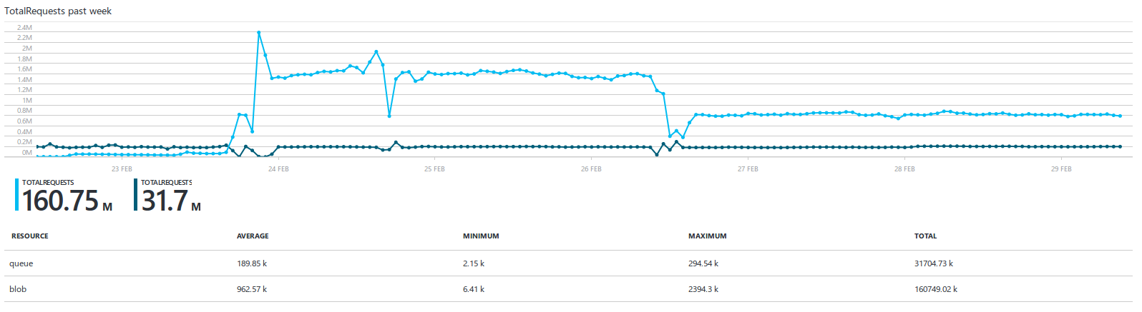
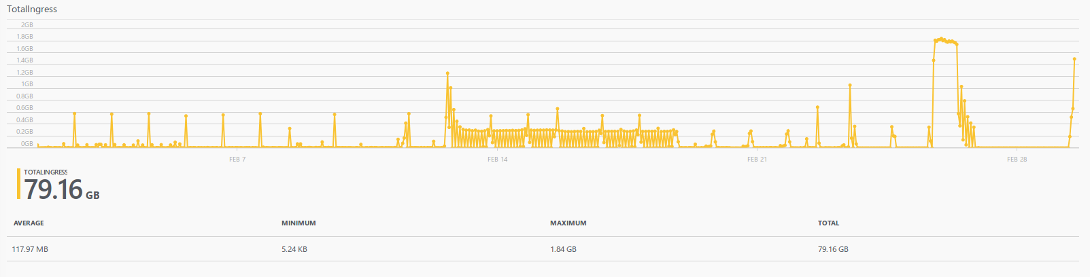
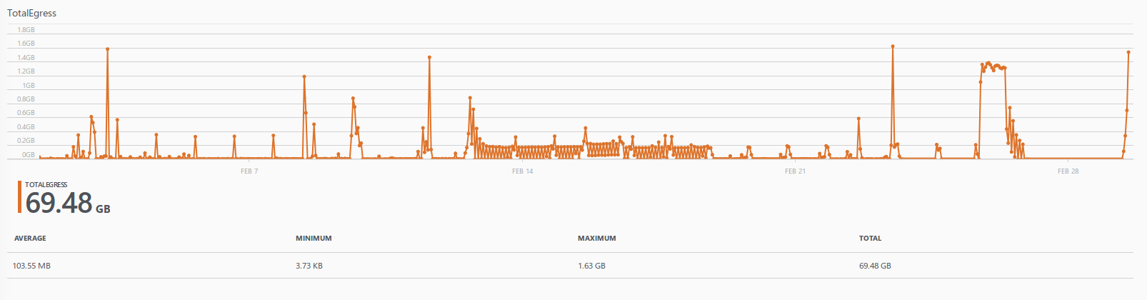
UrbanWater Main results
Data Management Cloud Platform (DMCP)
Volumes from last week of February 2016.
http://www.urbanwater-ict.com

Slide 28
3. Lessons learned and the future
http://www.urbanwater-ict.com

Slide 29
Lessons learned and the future
Plan for the past and the future
Wide variety of systems connected to the platform, both old and new
Old systems barely manage FTP while modern systems are happy with Service Bus
Varying levels of security. Partition sensitive data from general data
Expect high frequency data and large BLOB’s of data
Expect requirements to change. Have a plan for post collection data analytics
Be prepared for regulation changes whether its grant funding rules for utilities such as AMP6 or data privacy regulation changes
http://www.urbanwater-ict.com

Slide 30

Lessons learned and the future
Blockchain (Ethereum)
Banking and finance going wild for Blockchain for the benefits of privacy, proof, transparency and interoperability
No need to hide data in remote cloud datacentres, services such as UrbanWater can continue to use Blockchain for convenience while allowing direct access to data
Proof that readings are accurate without ability to post-doctor data
Smart contracts allow a whole new generation of smart services such as automatic checking of meter readings and instant payments in a very transparent way
Truly decentralises network while allowing customers and utilities to control what they need to control
https://www.ethereum.org/
http://www.coindesk.com/technology/smart-contracts-news/ethereum/
http://www.urbanwater-ict.com

Slide 31

Lessons learned and the future
Security and privacy
Defcon presented many vulnerable systems considered parts of a modern smart city
Demonstration of hacking every solar PV array in America through a vulnerable home solar PV installation
Mobile phones to smart meters, a new frontier for hackers.
More integrated systems means more potential to traverse smart systems as part of a single hack
Encrypted data in storage. What needs to be encrypted and if encrypted what are the impacts for data mining? Homomorphic?
Excited talk within the hacker space about the new opportunities that come from smart cities
http://www.urbanwater-ict.com

Slide 32


Lessons learned and the future
Integration
More integrated systems such as Traffic Control talking to Energy Management
Water utilities using solar energy and low cost energy periods to pump water uphill to release and generate energy at night and high energy cost periods
IoT devices, small devices for the person or home and smart household apppliances
Smart Cars and other Smart Vehicles (beware the security)
Distributed computing / Peer to Peer as well as Cloud
http://www.urbanwater-ict.com

